Slide 1
Contributions of Center of Mass Velocity to Ball Velocity at Release in Basketball Shots Initiated with and without Momentum
Casey Wiens¹ and Jill L. McNitt-Gray^{1,2}
¹Departments of Biological Sciences and ²Biomedical Engineering, University of Southern California, Los Angeles, CA
Email: cwiens@usc.edu

Slide 2
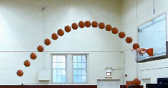
Mechanical Objective of a Shot in Basketball
Ball Trajectory Defined at Release
Shot Type
Ball
Vertical
Velocity
Step In
Potential
to Change
CM Vertical Velocity
at Release
Jump Shot
Ball
Horizontal
Velocity
Free Throw
at Release
Foul Line
Same Horizontal Displacement (4.62 m; 15 ft)
Notes:
Theoretical release and entry angles
Each shot type potentially affords different center of mass vertical velocities

Slide 3
Hypothesis:
Center of Mass vertical velocity contribution to Ball vertical velocity at Release
Close
<
<
Long
Medium
Arm
Arm
Ball
Arm
Ball
Ball
CM
CM
CM

Slide 4
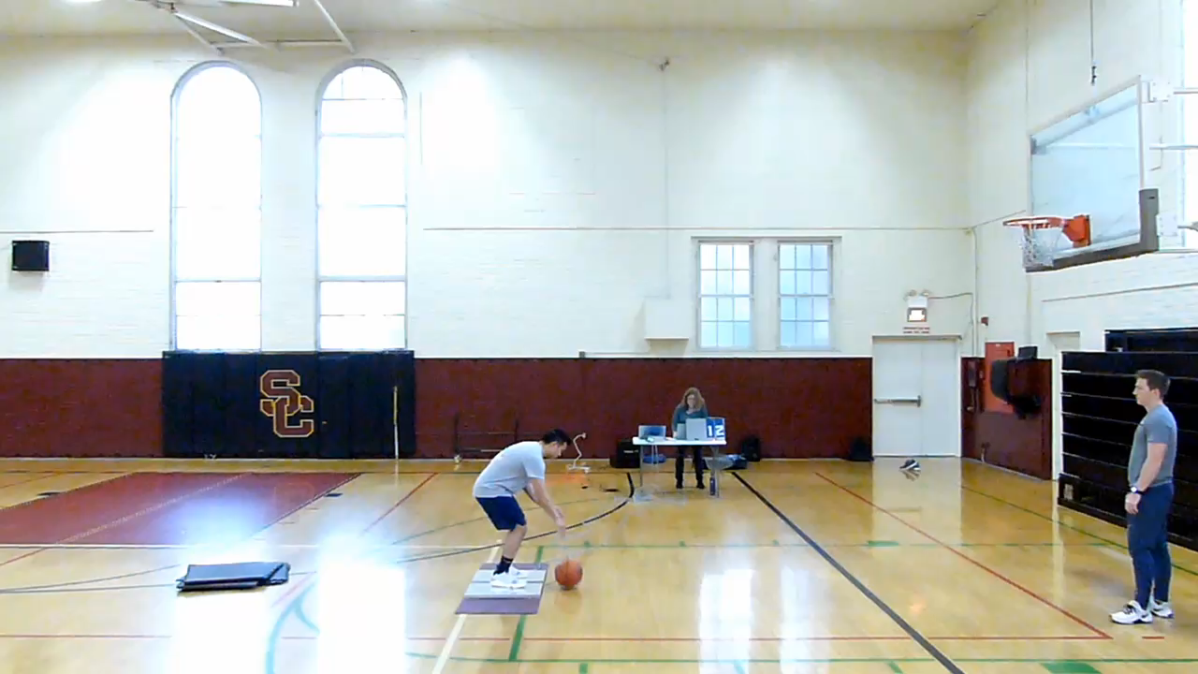
Free Throw
n = 8 Recreational Players
Motion Capture
(Panasonic, 120 Hz)
- ball and body
Two Force Plates
(Kistler, 1200 Hz)
- net vertical impulse
Center of Mass Vertical Velocity
- at plate departure
- at release
Ball Velocity
- at release

Slide 5
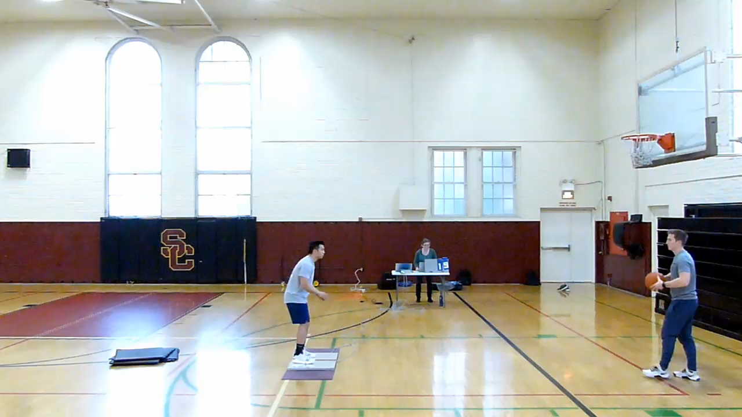
Jump Shot
n = 8 Recreational Players
Motion Capture
(Panasonic, 120 Hz)
- ball and body
Two Force Plates
(Kistler, 1200 Hz)
- net vertical impulse
Center of Mass Vertical Velocity
- at plate departure
- at release
Ball Velocity
- at release

Slide 6
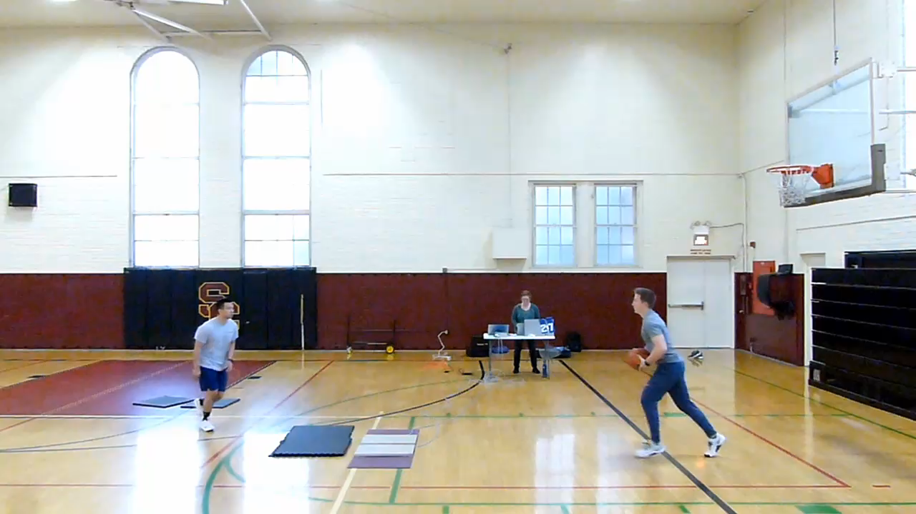
Step-in
n = 8 Recreational Players
Motion Capture
(Panasonic, 120 Hz)
- ball and body
Two Force Plates
(Kistler, 1200 Hz)
- net vertical impulse
Center of Mass Vertical Velocity
- at plate departure
- at release
Ball Velocity
- at release

Slide 7
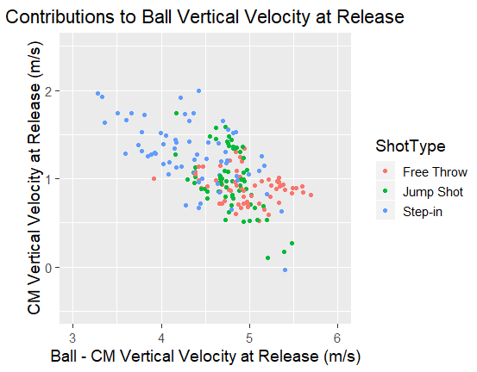
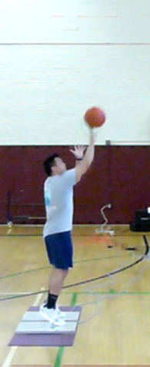
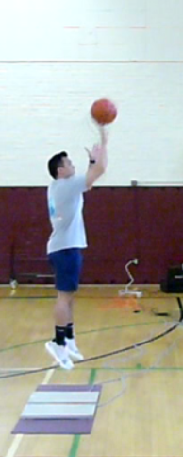
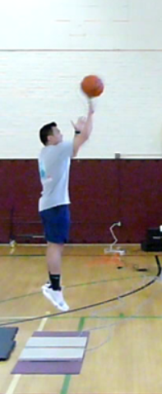
CM vs Arm Vv Contribution to Ball Vv at Release
Free Throw
Jump Shot
Step-in
CM Vertical Velocity at Release (m/s)
“Arm Contribution”

Slide 8
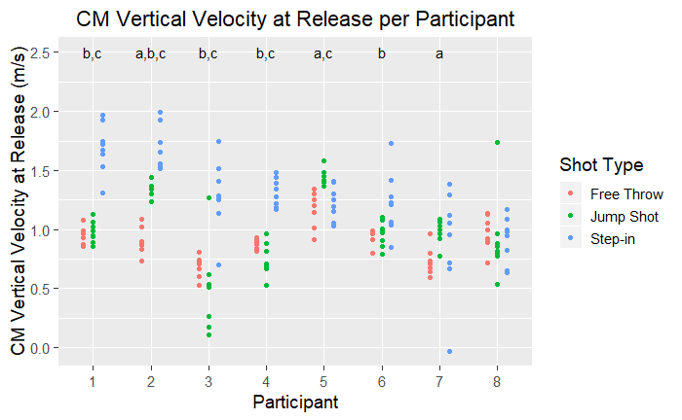
CM Vv at Release is Greater with Step-in
Free Throw
Jump Shot
Step-in
a
b
c
* significant
CM Vv
CM Vv
Free < Step
Jump < Step

Slide 9
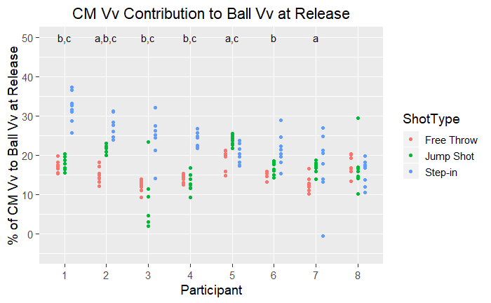
CM Vv Contribution to Ball Vv at Release
Free Throw
Jump Shot
Step-in
CM Contribution
Free < Jump < Step
Notes:
Box around participant 4 to highlight the pictures

Slide 10
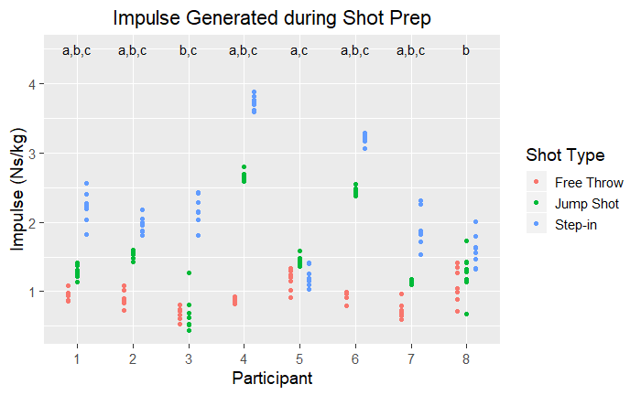
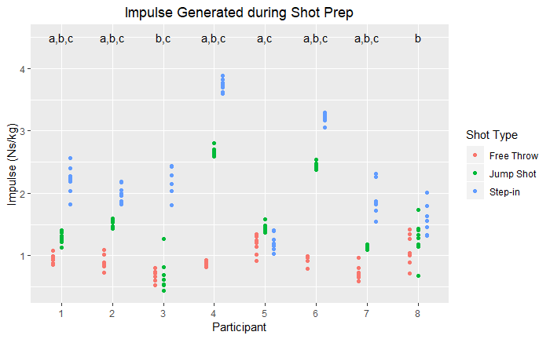
Impulse Generated during Shot Prep
Free Throw
Jump Shot
Step-in
Free < Jump < Step

Slide 11
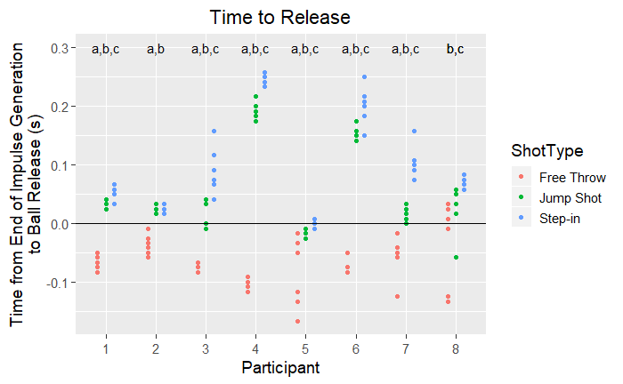
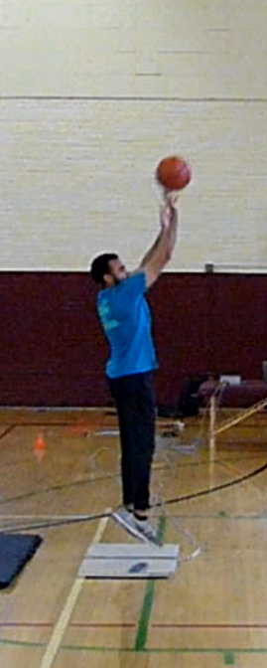
Time to Release
Step-in
Step-in
Free < Jump < Step
P1 - Early
P4 -Late
Notes:
Group level – all comparisons significant

Slide 12
Similarities in
Impulse Generation
and Time to Release
Notes:
Group level – all comparisons significant

Slide 13
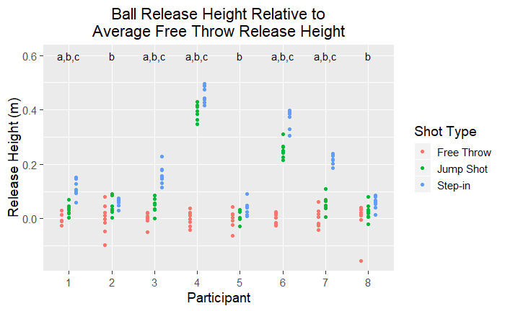
Release Height
Free Throw
Jump Shot
Step-in
Free < Jump < Step
Notes:
Group level – all comparisons significant

Slide 14
- Greater CM Vv at Departure
- Ball Release later in flight
when CM Vv less
Notes:
Group level – all comparisons significant

Slide 15
Discussion
Center of Mass vertical velocity contribution to Ball vertical velocity at Release
Free Throw
<
<
Group:
Jump Shot
Step-In
Individuals: 6 of 8 significant difference between Free and Jump and/or Step-in
Height of ball Release varied between players and depended on
Vertical impulse generated by legs during shot preparation
Timing of ball release relative to end of impulse generation

